Slide 1


LokKartavya
A Fact-Based Platform for Civic Awareness & Transparency
Understanding public leadership through verified information

Slide 2
Problem We Identified
Scattered Information
Government data is fragmented and inconsistent.
Bias & Opinion
Social media and news often skew perceptions.
Complex Portals
Official sources are hard to navigate and understand.
Lack of Clarity
Citizens unclear on leader roles, responsibilities, and limits.
Result: Misinformation and low civic awareness.

Slide 3

OUR MISSION
Promoting Civic Literacy and Transparency
Enhanced Civic Awareness
Transparency in Governance
To empower citizens with accessible, verified information, fostering a deeper understanding of democratic processes.
To illuminate the functions of public office and the responsibilities of elected representatives within defined public roles.
Fact-Based Understanding
To present only factual data, official records, and responsibilities, strictly avoiding opinions or subjective judgments.
LokKartavya emphasizes public service and accountability over political personalities.

Slide 4
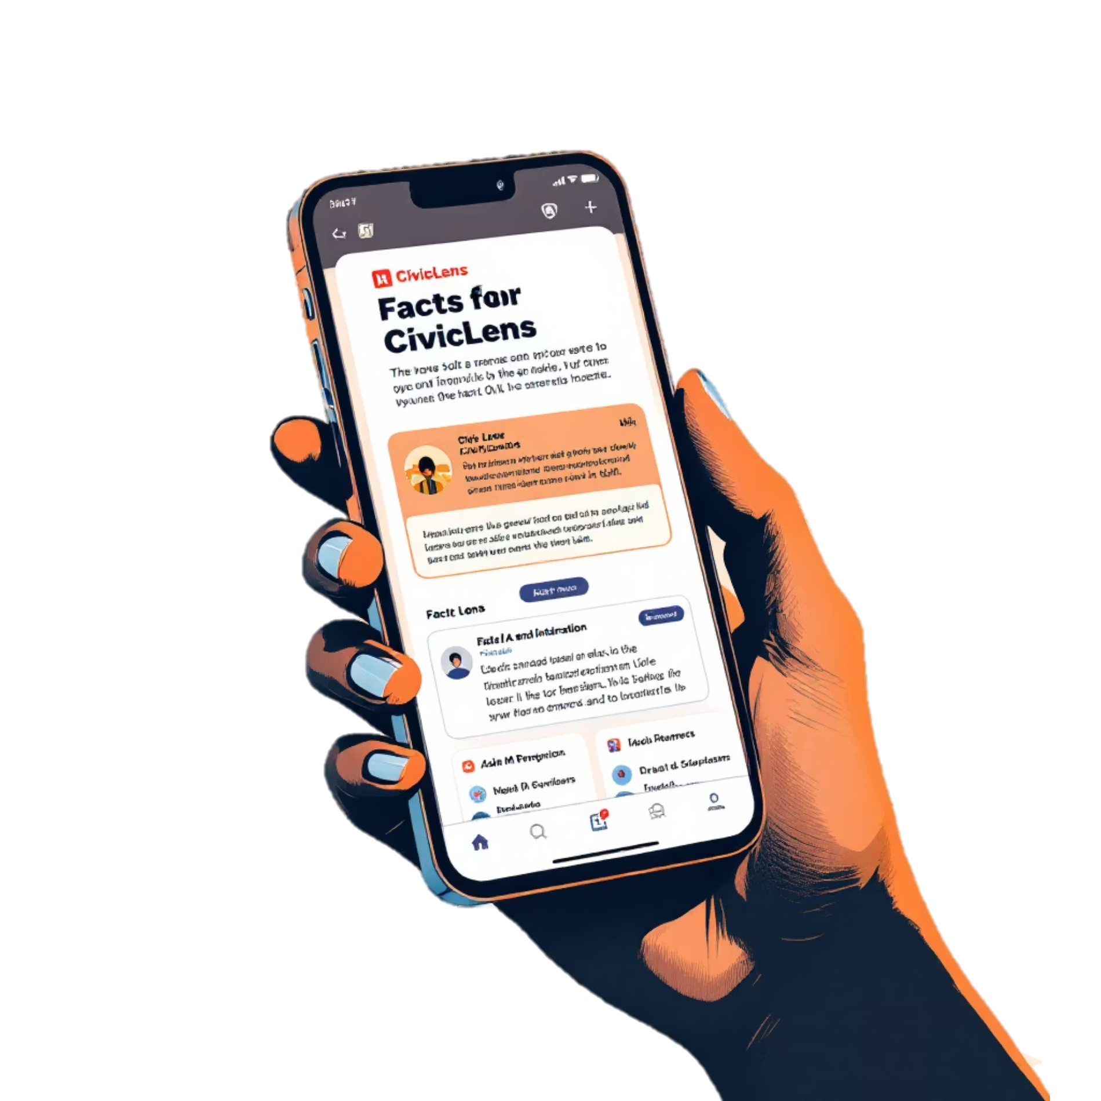
The Solution
Introducing LokKartavya : Your Mobile Civic Guide
LokKartavya is a specialized mobile application designed to bridge the gap between citizens and their government by providing unbiased, verifiable public information.
Verified Profiles: Fact-based insights into public leaders.
Role Explainers: Clear definitions of public office responsibilities.
Official Records: Access to public data and historical information.
Strict Neutrality: An unwavering commitment to political impartiality.
The app serves as a purely informational and educational resource.

Slide 5






Core Features
Key Functionalities of LokKartavya
Leader Profiles
Role Explanations
Factual background information on elected representatives.
Detailed breakdown of public office duties and limitations.
Commitment Tracker
Expenditure Overview
Monitor the status of officially announced public commitments.
Transparent display of public budget allocations.
Civic Issue Reporting
Source Transparency
Geo-tagged, image-based documentation of community issues.
Direct links to verified public data sources for all information.

Slide 6
Feature Deep Dive
Leader Background Profiles
Name and Office Held: Clear identification of the representative and their position.
Term Duration: Specific start and end dates of their current term.
Educational Background: Academic qualifications and institutions attended.
Professional History: Previous careers and public service roles before current office.
Key Responsibilities: Overview of their ministries and designated duties.
All profiles maintain a consistent, factual format, devoid of comparisons or commentary.

Slide 7

Understanding Governance
Role & Responsibility Explainer
Constitutional Roles
Clarifies the foundational duties and mandates of various public offices as outlined in governing documents.
Powers and Limitations
Defines the authorized scope of action and inherent restrictions of elected positions, fostering realistic expectations.
Civic Literacy Boost
Enhances public understanding of governmental structure and functions, promoting more informed citizen engagement.
This feature emphasizes the responsibilities of the office rather than the authority of the individual.

Slide 8
Transparency Tool
Public Commitments Tracker
Officially Announced
Tracks commitments made through official channels or public statements.
Categorized Status
Clearly indicates if a commitment is Completed, Ongoing, or if there is No Official Update available.
Source Verification
Provides direct links to the original public announcements or relevant official documents.
The tracker offers transparent status updates without ranking or performance judgment.

Slide 9
Empowering Citizens
Civic Issue Documentation Module
1
User Submissions
Citizens can upload geo-tagged images of local civic issues directly through the app.
2
Categorization
Issues are organized into key categories such as road conditions, water supply, public lighting, and sanitation.
3
Public Record Creation
Each submission contributes to a transparent, publicly accessible database of civic concerns.
This module facilitates data collection without comments, opinions, or blame attribution.

Slide 10
Impact & Conclusion
Global Impact :
Boosts Civic Literacy
1
Educates students and citizens.
Fosters Engagement
2
Encourages informed citizenship.
Reduces Misinformation
3
Provides reliable data.
Supports Transparency
4
Raises awareness of good governance.
Conclusion :
LokKartavya strengthens democracy by making public information clear, accessible, and neutral.
An informed citizenry is the foundation of a healthy democracy.

